Slide 1
Password Pusher
Presentation Resources
Apnotic LLC/Peter Giacomo Lombardo 2024

Slide 2
Overview
This presentation exists as a resource for your own presentations. It’s in basic white for easier copy/paste.
It includes:
Summaries, explanations & reasoning
Feature Overview
Security Overview
Graphics, logos and links

Slide 3
The Problem
Communication of Secure Data to Clients, Colleagues & Customers
Emailing passwords is inherently insecure
usually sent with context (e.g. email domain)
can be intercepted at multiple points by malicious entities
live in email archives forever
Passwords in email can be retrieved and used later on if an email account is ever stolen, cracked, abandoned etc..

Slide 4
The Problem
The same risks persist when sending passwords via
SMS
WhatsApp
Telegram
Teams Chat, Slack etc…
The data can and is often perpetual and out of your control.

Slide 5
Reducing Security Risks
By using Password Pusher, you bypass all of these issues
For each password sent with Password Pusher
a unique, hard to guess URL is generated that only you will know
passwords expire after a predefined set of views or duration
An audit log is maintained of views with metadata
Upon expiration, the payload is deleted immediately and entirely

Slide 6
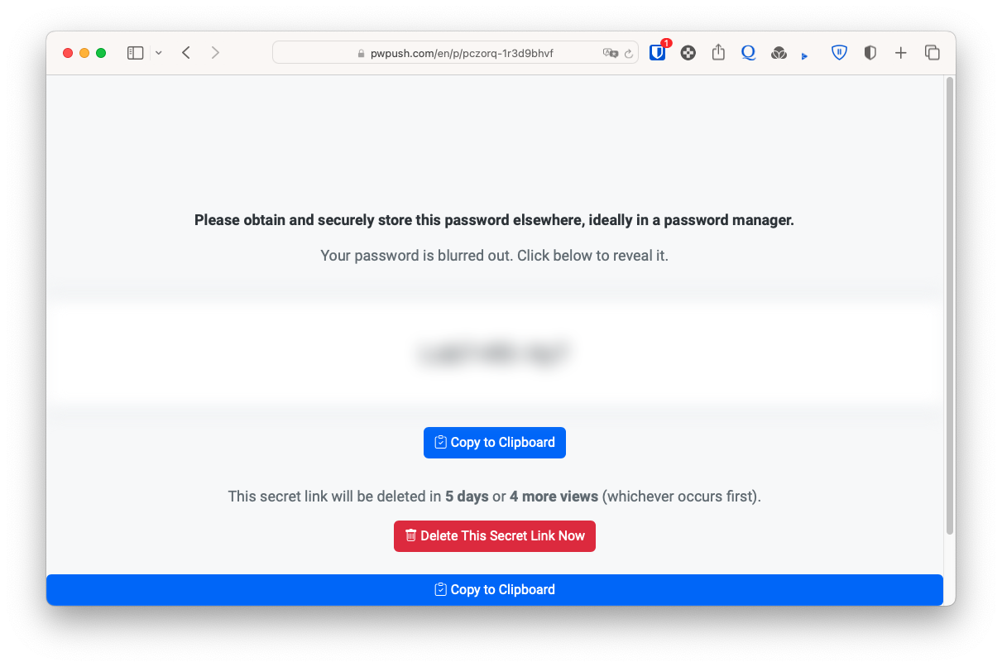
What End Users See
—-> https://pwpush.com/en/p/pczorq-1r3d9bhvf
Unbranded & Simple Delivery Page
No user confusion
Option to delete immediately

Slide 7
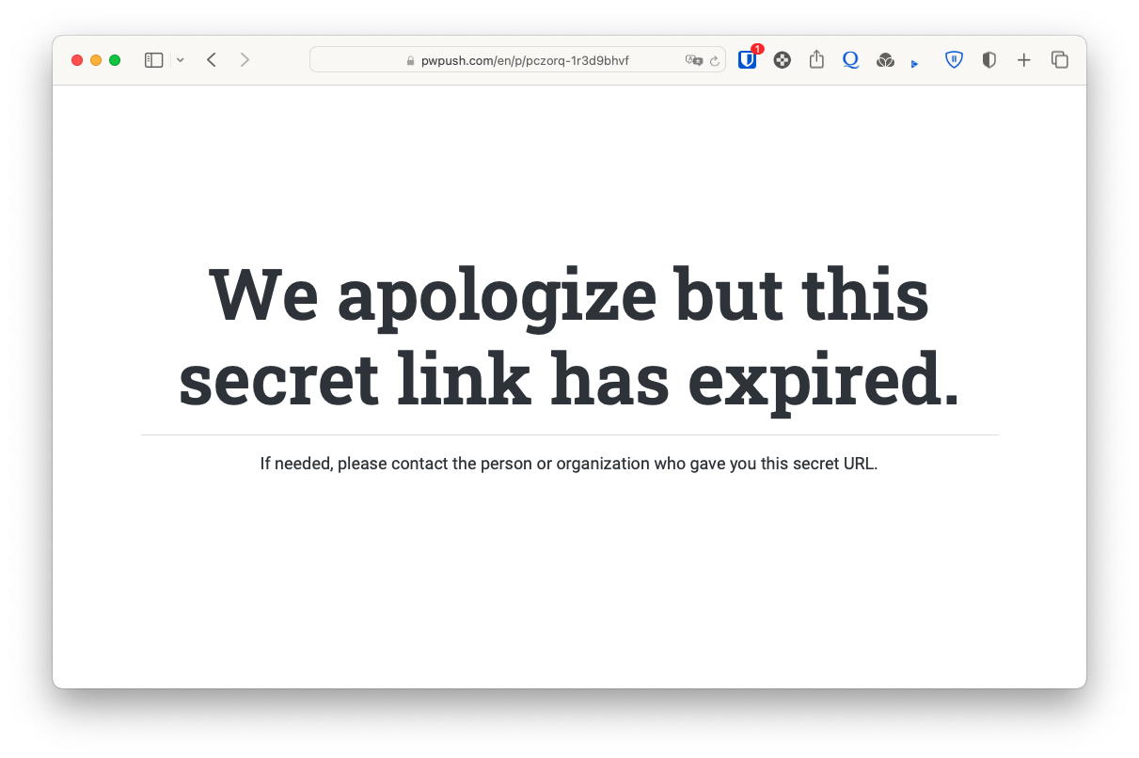
If Expired…
—-> https://pwpush.com/en/p/pczorq-1r3d9bhvf
Unbranded & Simple
No user confusion

Slide 8
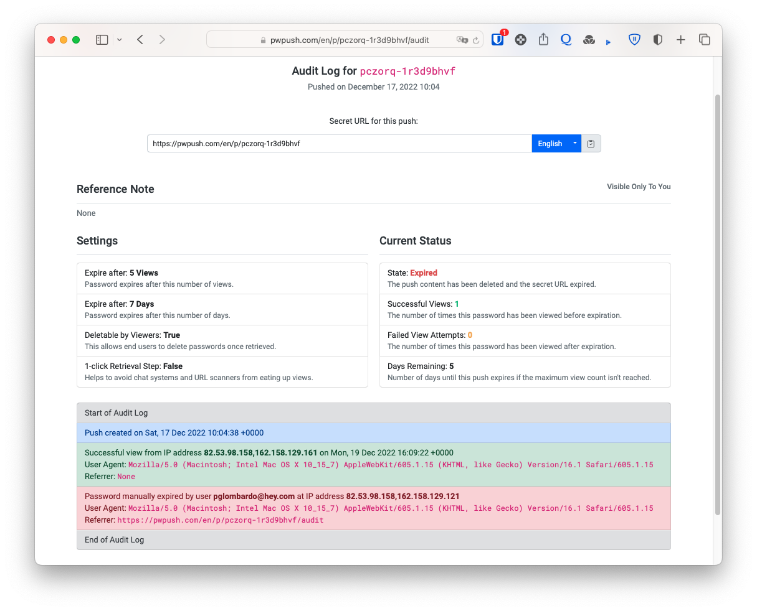
Track with Audit Logs
—-> https://pwpush.com/en/p/pczorq-1r3d9bhvf/audit
Know who viewed and when
Preemptively delete

Slide 9
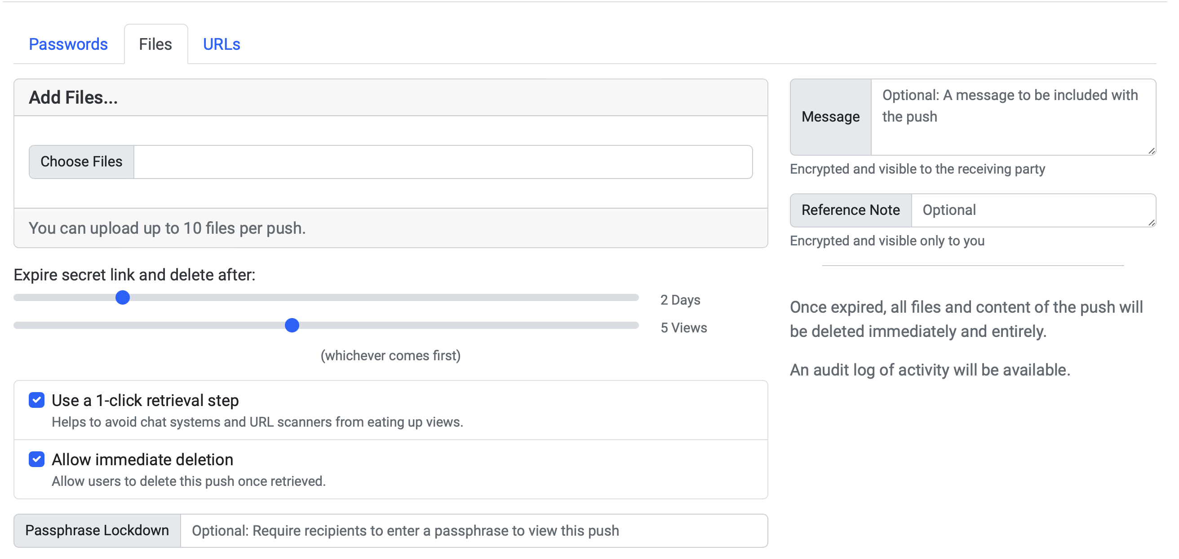
Share Text, Files & URLs

Slide 10
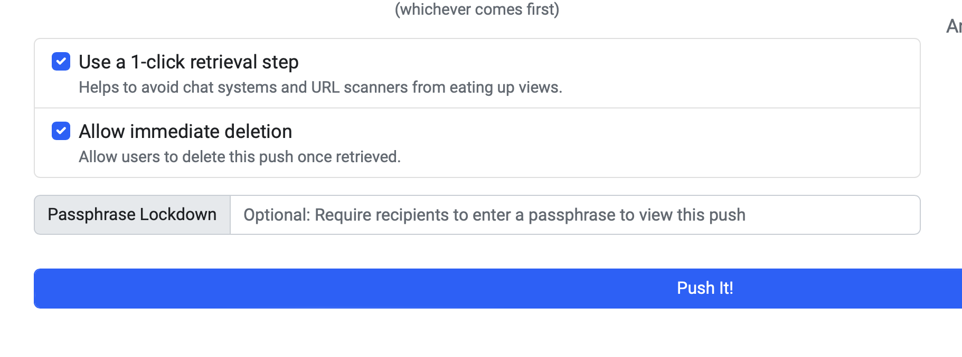
Passphrase Lockdown
Protect your pushes with pre-shared passphrases
Caption

Slide 11
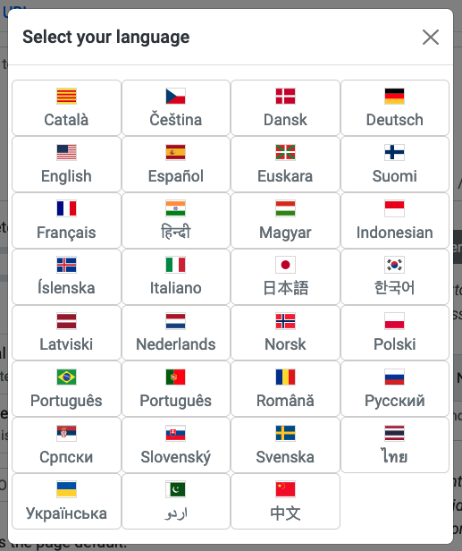
Translated into 30 Languages
Ability to set default language
Send shared items in other languages
Per user language settings

Slide 12
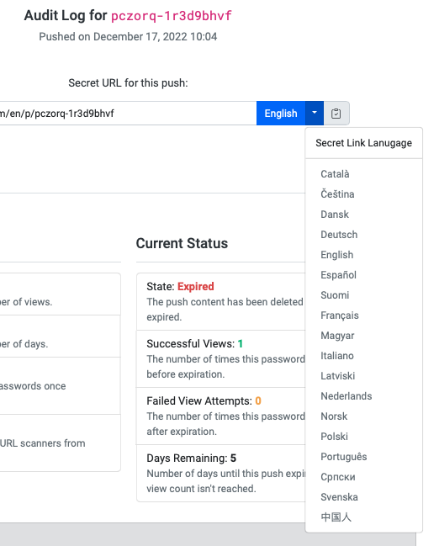
Send in Other Languages
Send secret URLs to international users in other languages

Slide 13
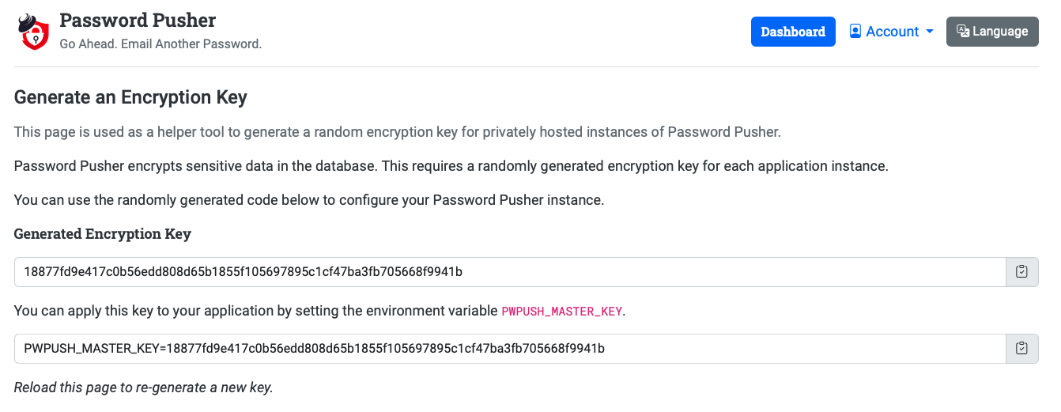
Encryption
What is in use?
Can be backed by Postgres, MySQL/MariaDB or ephemeral
Sensitive data is encrypted using AES-GCM and deleted on expiration
Private/on-prem instances can set a custom encryption key

Slide 14
Trust
Can you trust Password Pusher?
Available publicly at https://pwpush.com or can be hosted privately (on-prem)
It’s >10 years old, open source and has been reviewed many times over
Author is an active technology engineer with a long and public profile
Actively maintained for the the >10 year life of the project
pwpush.com hosts ~180k/users a month as of 2024
Hundreds to thousands of private instances running

Slide 15
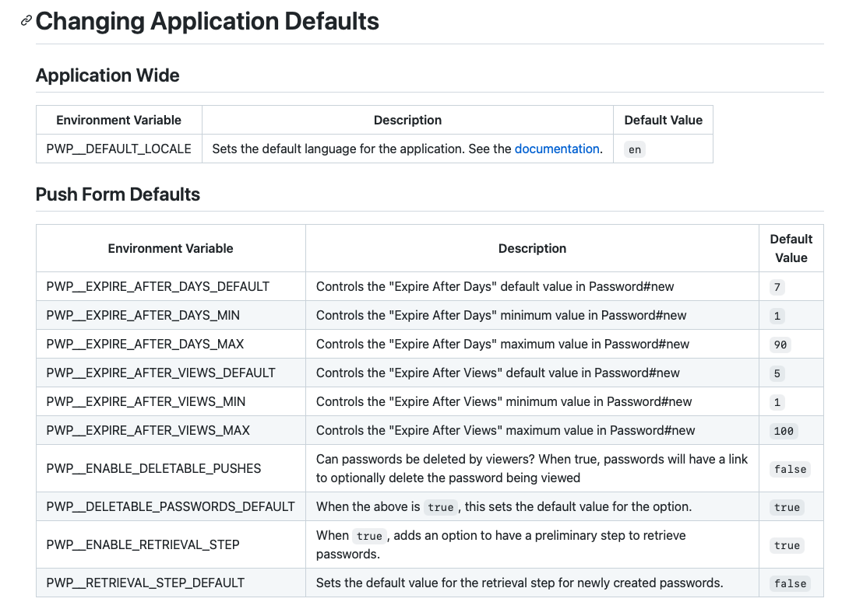
Configuration
Can it be customised?
Almost every facet can be customised/changed
Configuration via settings.yml file or environment variables

Slide 16
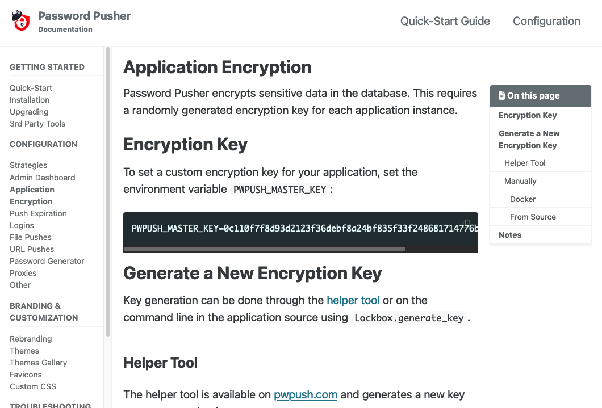
Extensive Documentation
https://docs.pwpush.com
Mature documentation that is updated with every release

Slide 17
Deployment
Use pwpush.com or host your own…
Docker containers available with docker-compose recipes
Can be (and often is) deployed to:
AWS
Digital Ocean
Heroku
Google Cloud
Openshift

Slide 18
Self-Hosted
Pros vs. Cons
Pros
Cons
peace of mind that you know exactly what code is running
configure and run it as you like
branded for your org
If your instance gets hacked and encryption broken, attackers now have a targeted dictionary of passwords for your org (limited to unexpired pushes)
In this specific case, pwpush.com may be a better choice since there is no direct correlation to your organisation.
Setup your own SSL & secure database
Organisations should carefully weigh the pros and cons and decide which route is best for them. We happily support both strategies.

Slide 19
What does it look like?
Visuals
The next slides will visually demonstrate the Password Pusher UI and some of its features.

Slide 20
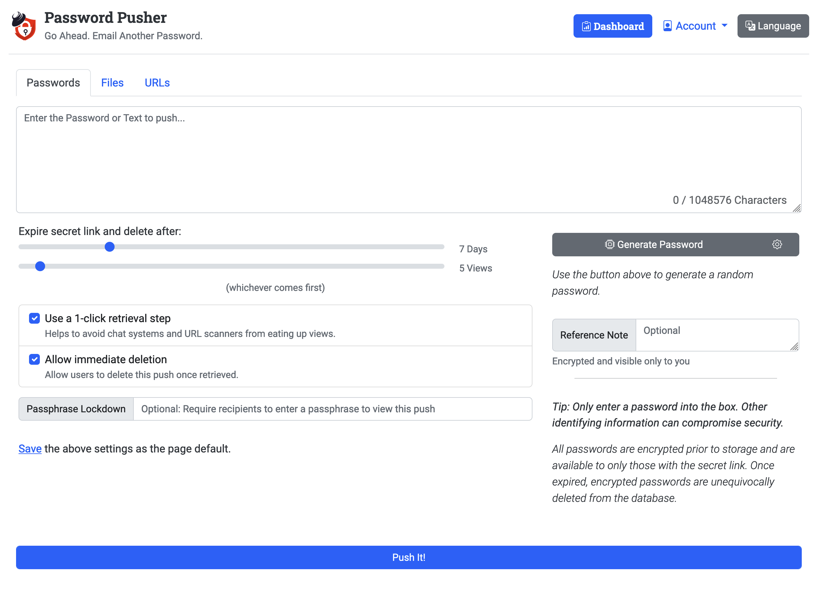
Entry Form

Slide 21
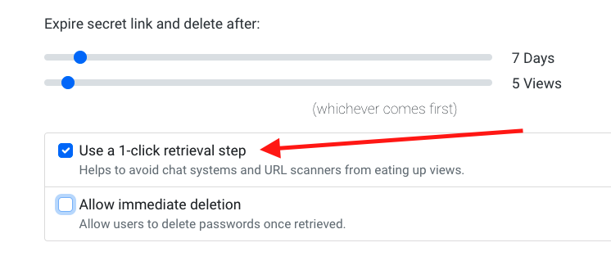
Expiration Options

Slide 22
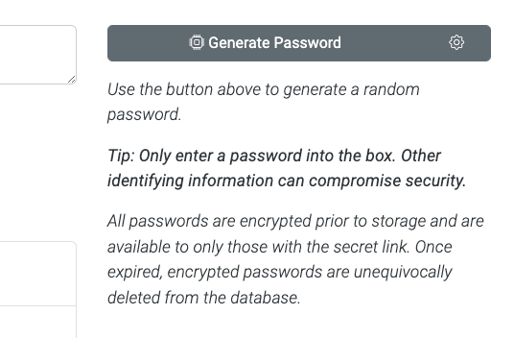
Tips: Entry without context

Slide 23
Dashboard to Track Pushes

Slide 24
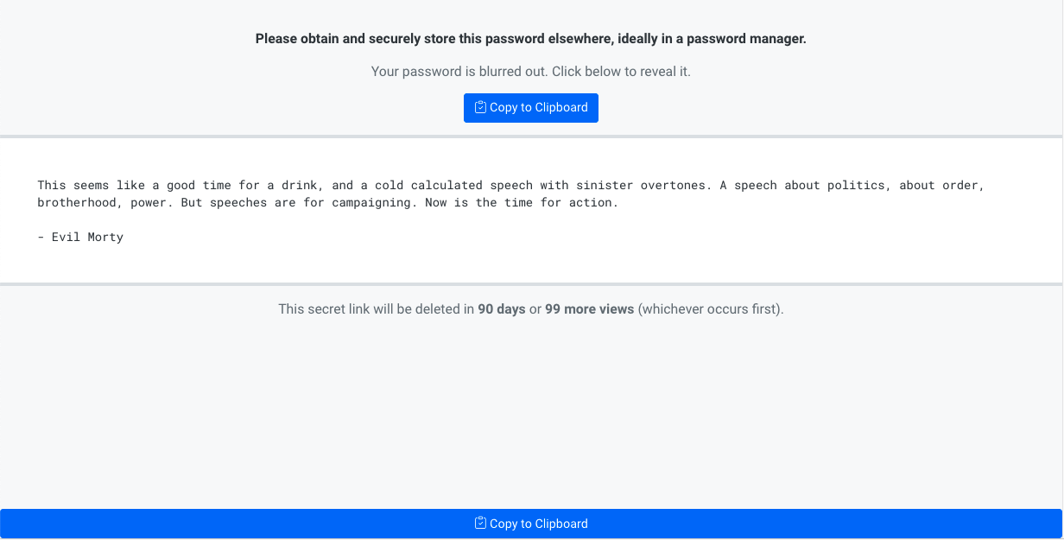
Unbranded Delivery Pages

Slide 25
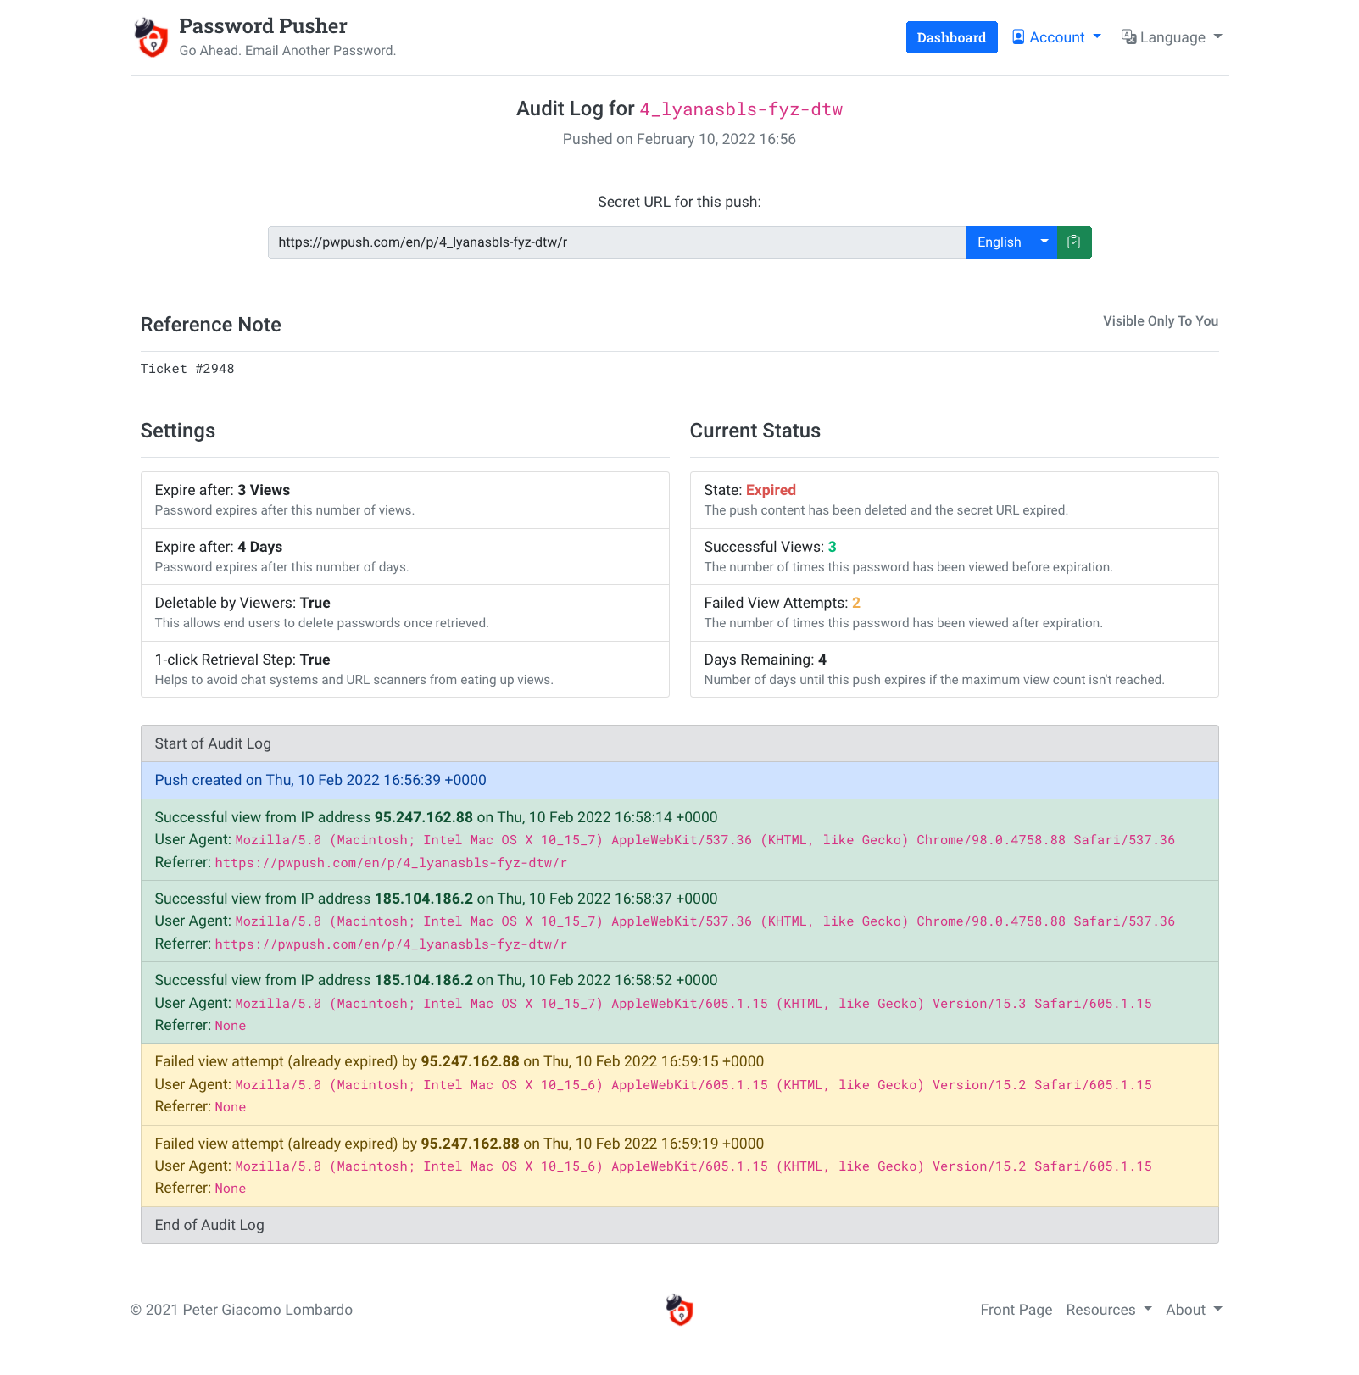
Audit Log
for a “push”

Slide 26
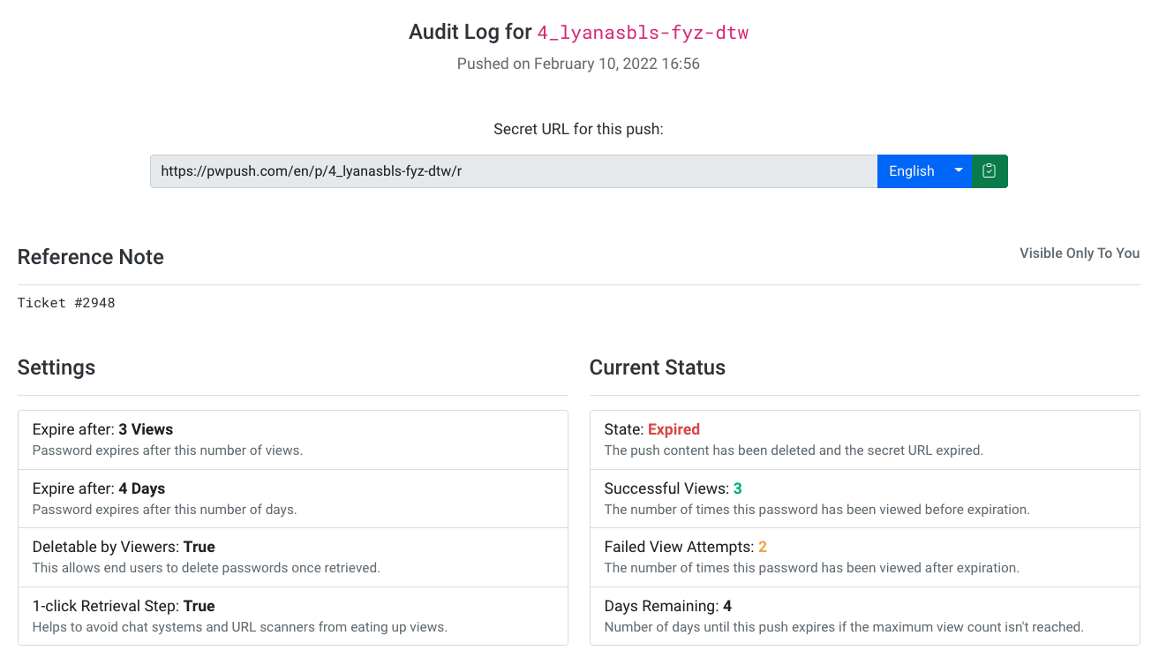
Audit Log for a “push” (close up)

Slide 27
Audit Log for a “push” (close up)

Slide 28
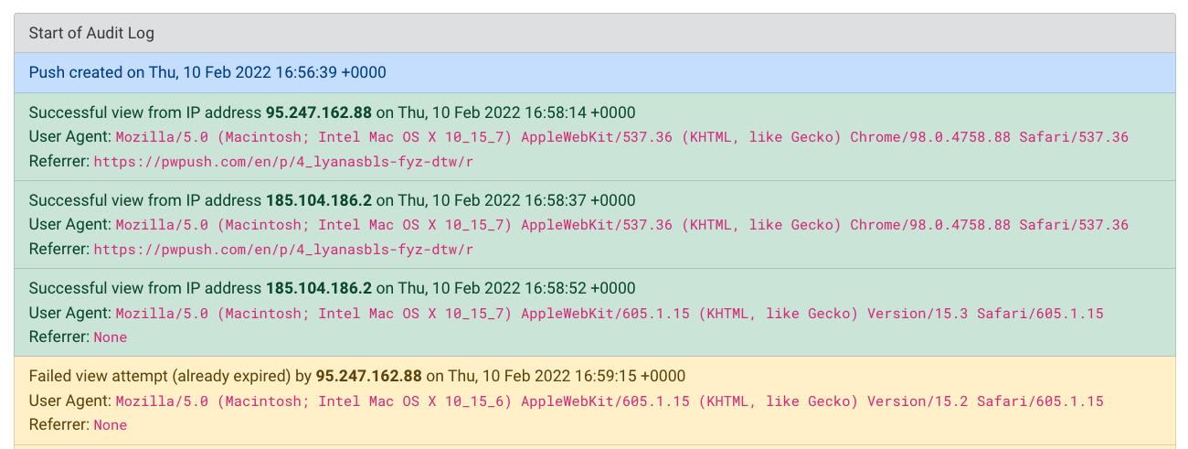
Audit Log for a “push” (close up)

Slide 29
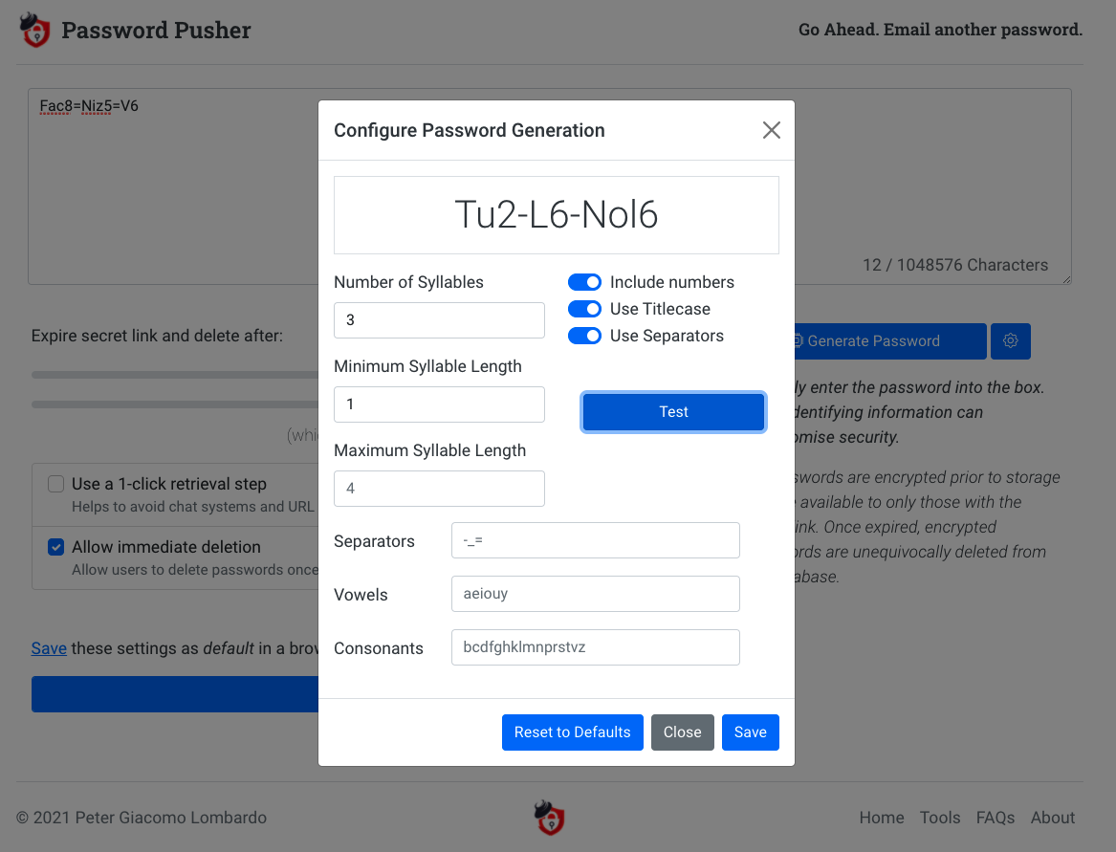
Configure
Password
Generator

Slide 30
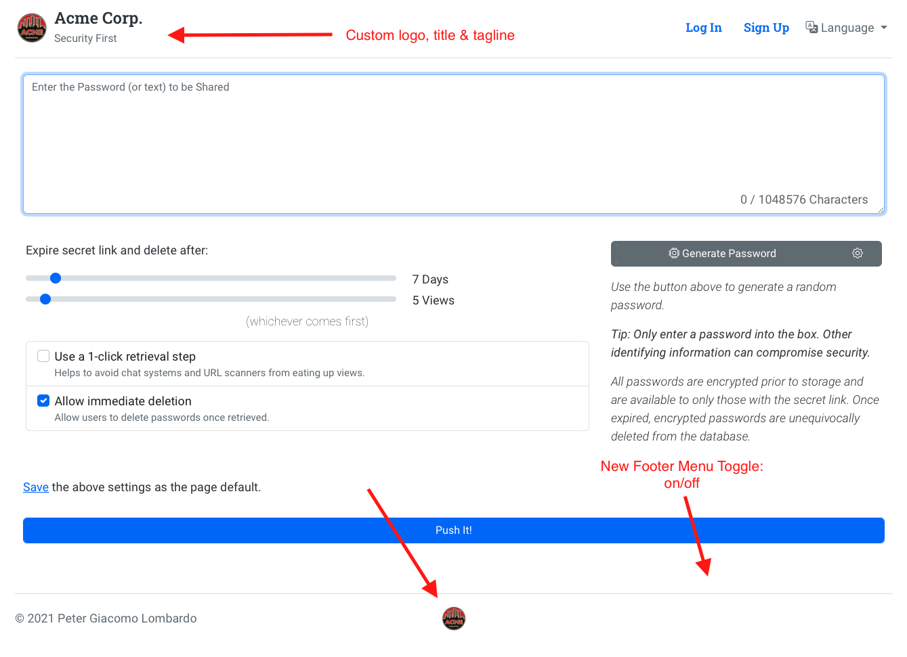
Rebranding

Slide 31
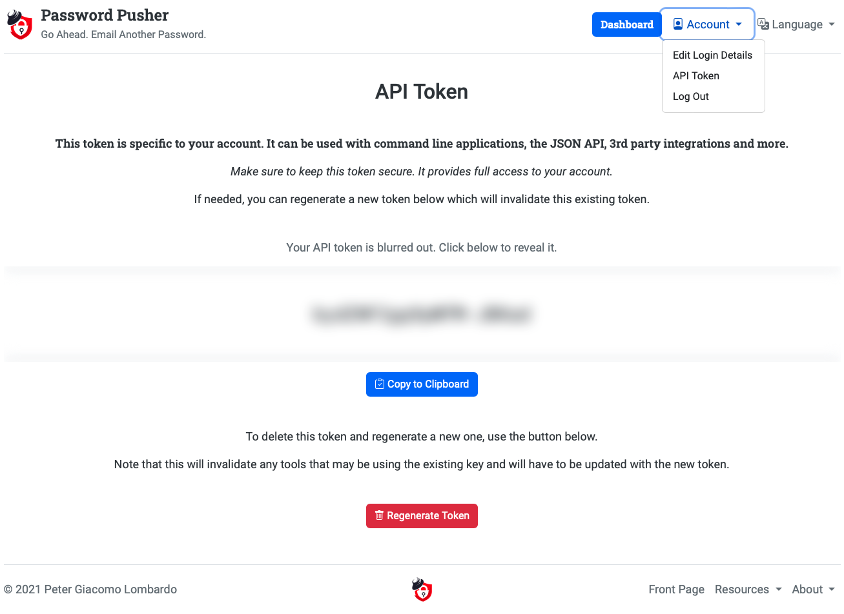
Authenticated JSON API

Slide 32
Translated into 30 languages

Slide 33
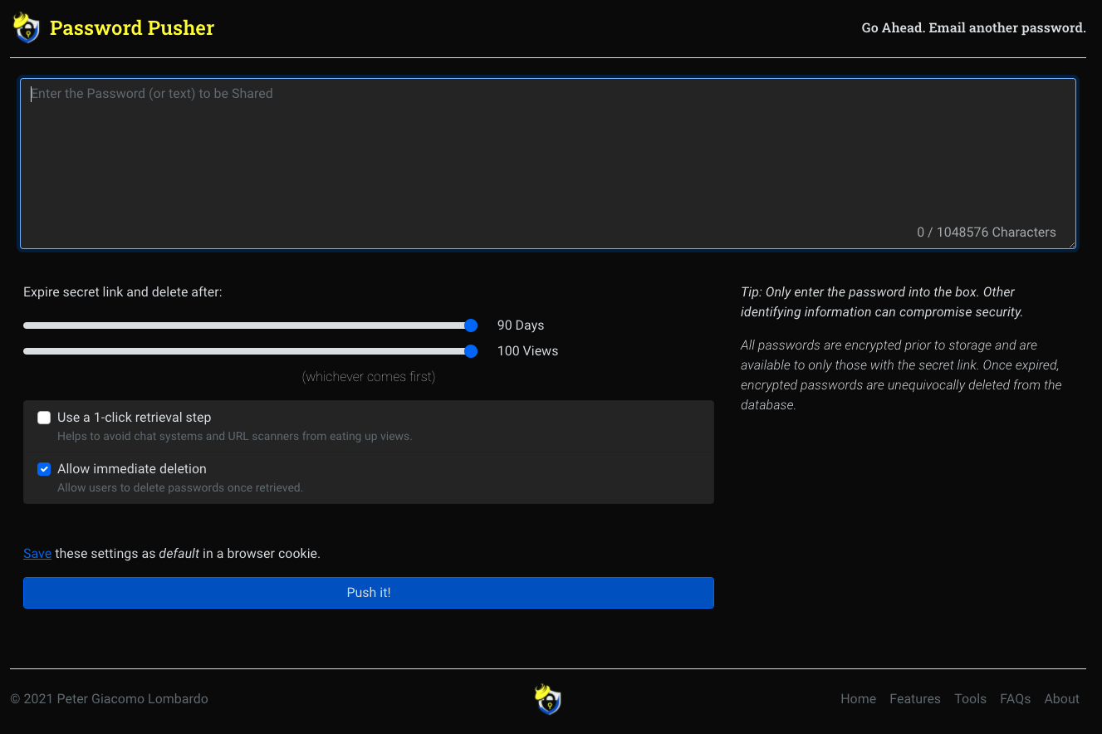
Dark Theme

Slide 34
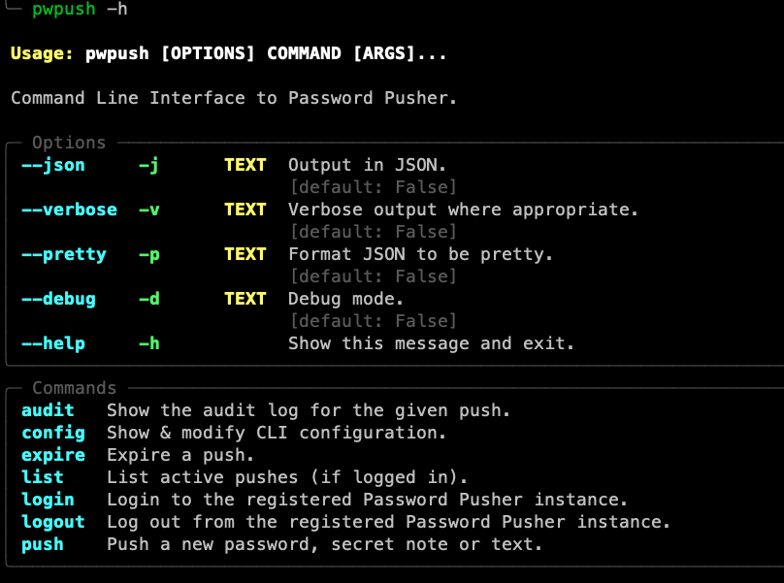
Authenticated CLI Available
to automate password
distribution

Slide 35
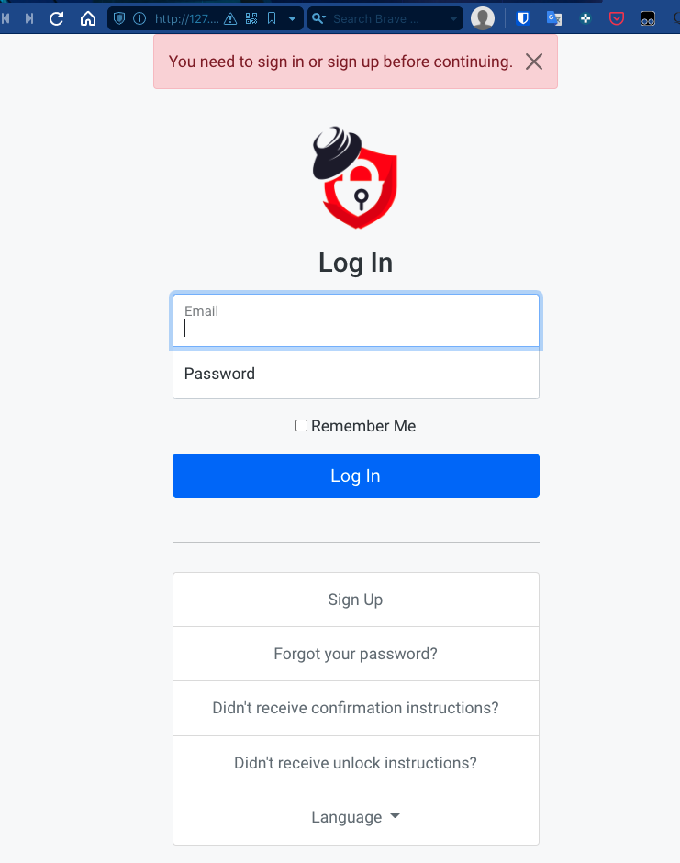
Logins Optional

Slide 36
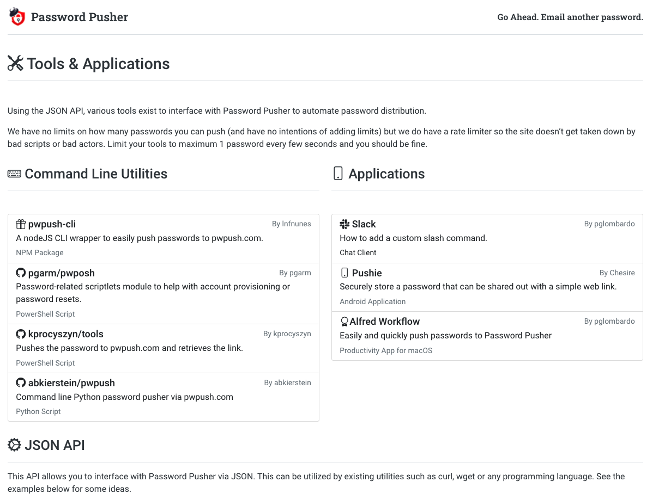
Many 3rd Party Tools

Slide 37
Set Your Own Encryption Key

Slide 38
Password Pusher Links
Public Site: pwpush.com
FAQ: https://pwpush.com/en/pages/faq
Documentation: https://docs.pwpush.com
Twitter: https://twitter.com/pwpush
Facebook: https://www.facebook.com/pwpush
Source Code: https://github.com/pglombardo/PasswordPusher

Slide 39
Author & Source
Peter Giacomo Lombardo
LinkedIn: https://www.linkedin.com/in/peterlombardo/
Github: https://github.com/pglombardo
Blog: https://the0x00.dev
Password Pusher Source Code: https://github.com/pglombardo/PasswordPusher
Thanks for your interest in Password Pusher! If you ever have an issue or need some help with the project, please let me know in the pwpush.com feedback form or by email at pglombardo@pwpush.com.

